Slide 1
Learning

Slide 2
Learning
Learning: a relatively permanent change in an organism’s behavior due to experience.
Helps us adapt: our capacity to learn new behaviors that help us cope with changing circumstances.
Helps us predict future likelihood of things based on prior learning/experience.

Slide 3
Learning
Associative Learning: learning that certain events occur together (stimulus – response).
Classical conditioning: two stimuli occur together.
Operant conditioning: a behavior and its consequences.
Reflects Behaviorist viewpoint.
Cognitive & Evolutionary Perspectives: take into account mental processes and evolutionarily beneficial behaviors.
Habituation
Sensitization
Observational
Latent

Slide 4
Learning
Obstacles to learning:
Task(s) not broken down into adequately small steps.
Poor directions or lack of clarity.
Lack of reinforcement.

Slide 5
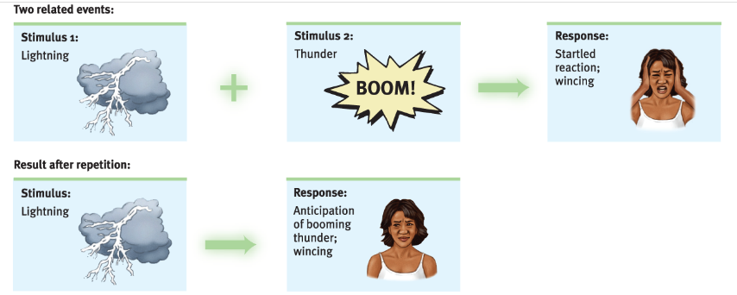
Classical Conditioning
Classical conditioning: learning to associate two stimuli and thus to anticipate events.

Slide 6
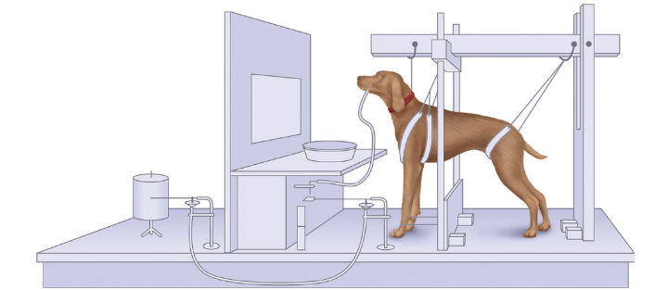
Classical Conditioning
Pavlov’s dogs:
Measured amount of saliva produced by dogs when presented food.
Paired food with a neutral stimulus.
Dogs learned to associate sound with food delivery.

Slide 7
Classical Conditioning
Pavlov set the foundation for Watson’s Behaviorism:
View that psychology should be an objective science that studies observable behavior without reference to mental processes (consciousness).
Basic laws of learning same for all animals: stimulus + observable response.

Slide 8
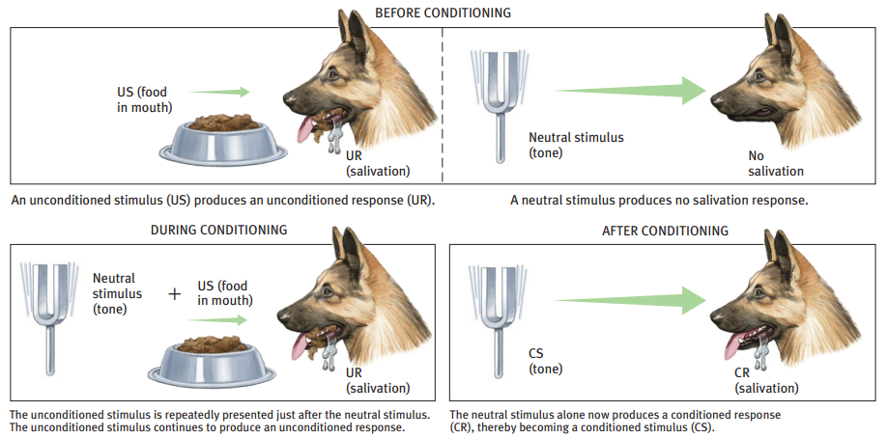
Classical Conditioning

Slide 9
Classical Conditioning
Unconditioned stimulus (US)
A stimulus that naturally and automatically triggers a response.
Unconditioned response (UR)
A naturally occurring response to the US.
Conditioned stimulus (CS)
An originally irrelevant stimulus that, after association with an US, comes to trigger a conditioned response.
Conditioned response (CR)
The learned response to a previously neutral (but now conditioned) stimulus.

Slide 10
Classical Conditioning
US
UR
Neutral Stimulus
US
UR
CS
CR

Slide 11
Classical Conditioning Example 1
The smell of cake makes your mouth water.
Unconditioned stimulus:
Unconditioned response:
Conditioned stimulus:
Conditioned response:

Slide 12
Classical Conditioning Example 2
You go to the eye doctor and they do a glaucoma test in which the machine shoots a puff of air into your eyeball. Now you flinch when you sit down at the machine.
Unconditioned stimulus:
Unconditioned response:
Conditioned stimulus:
Conditioned response:

Slide 13
Classical Conditioning Example 3
My children love video games. I used to teach on Monday and Wednesday evenings and they would get to play video games while I was gone. Soon, on Mondays and Wednesdays, they would get excited.
Unconditioned stimulus:
Unconditioned response:
Conditioned stimulus:
Conditioned response:

Slide 14
Classical Conditioning Example 4
Smiling and feeling happy when you hear the Mario theme song.
OR
Feeling anxious when you hear the Bowser’s Castle music.
Unconditioned stimulus:
Unconditioned response:
Conditioned stimulus:
Conditioned response:

Slide 15
Classical Conditioning
The Office Classical Conditioning. – YouTube
Unconditioned stimulus:
Unconditioned response:
Conditioned stimulus:
Conditioned response:

Slide 16
Classical Conditioning Activity
Work alone or in groups.

Slide 17
Classical Conditioning
Acquisition
The learning phase of classical conditioning.
Conditioned response increases in strength as the conditioned stimulus is paired more often with the unconditioned stimulus.
Timing matters: learning is faster when the conditioned stimulus and the unconditioned stimulus are presented closer in time rather than having a delay between them.
Helps us predict: if conditioned stimulus follows the unconditioned stimulus, learning is less likely to occur.
Learning occurs more rapidly if the conditioned stimulus is unfamiliar.

Slide 18
Classical Conditioning
Extinction
The gradual reduction and eventual loss of the conditioning/ association.
Not the same as forgetting, it is weakening of the association.
Gradual loss of the conditioned response occurs after the conditioned stimulus is presented repeatedly without the unconditioned stimulus.
Spontaneous recovery
Sudden re-emergence of an extinct conditioned response (often in a weaker form) after a delay in exposure to the conditioned stimulus.

Slide 19
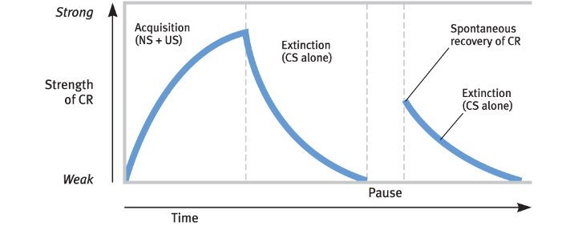
Classical Conditioning

Slide 20
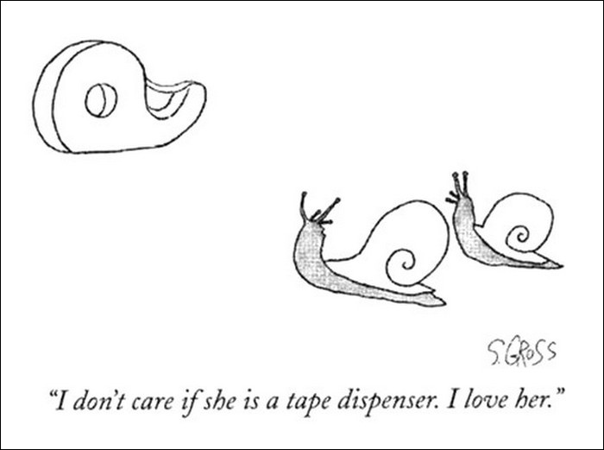
Classical Conditioning
Stimulus generalization
Process by which stimuli that are similar (but not identical) to the original conditioned stimulus elicits the conditioned response.
Stimulus discrimination
Process by which stimuli that are different from the conditioned stimulus result in no conditioned response at all.

Slide 21
Classical Conditioning
Case study: Little Albert
The Little Albert Experiment | Watson & Rayner (1920) – YouTube
Showed stimulus generalization.
Ethical & research issues:
Do no harm.
No ability to withdraw.
No informed consent or debriefing.
N of 1.
Follow-up study from Watson’s student on inanimate objects.

Slide 22
Classical Conditioning
Counter-conditioning: can be used in therapies to treat phobias.
Pair feared stimulus with a positive stimulus.
Exposure therapy.
Spontaneous recovery could occur.
Re-conditioning
Usually happens more quickly than original conditioning.

Slide 23
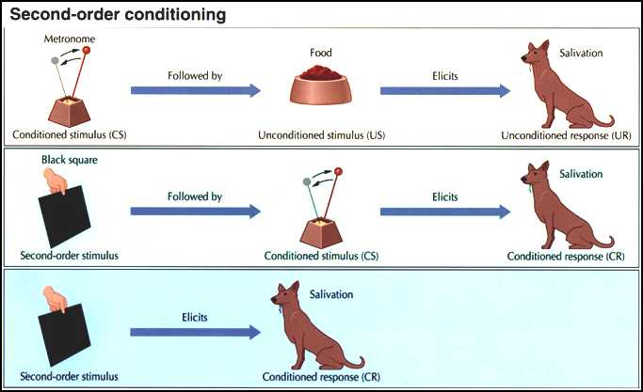
Higher-Order Conditioning

Slide 24
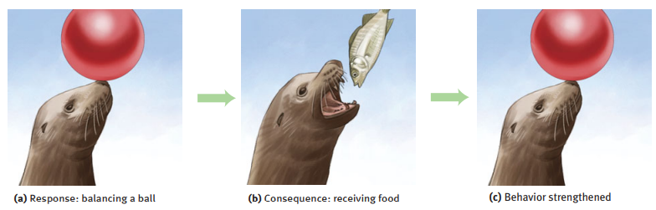
Operant Conditioning
Operant conditioning: learning in which the consequences of the organism’s behavior affect the likelihood that it will repeat the behavior.
Repeating acts that are followed by good results.
Avoiding acts that are followed by bad results.

Slide 25
Operant vs. Classical Conditioning
Classical Conditioning | Operant Conditioning
Target behavior elicited automatically Stimulus → Response | Target behavior exhibited voluntarily Behavior → reinforcer/ punishment
Once conditioned, the behavior will occur even in the absence of the reward. | Reward contingent on behavior.
Is the organism learning associations between events it does not control? | Is the organism learning associations between its behavior and resulting events?

Slide 26
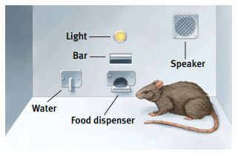
Operant Conditioning
Thorndike’s Law of Effect
If a consequence is favorable, the behavior becomes more frequent.
If a consequence in unfavorable, the behavior becomes less frequent.
Operant chamber (aka Skinner box)
Rat increases or decreases behavior depending on result of pushing bar.

Slide 27
Operant Conditioning
Shaping: progressively reinforcing behaviors that come closer and closer to the target behavior.
Shaping with Skinner box
BF Skinner Foundation - Pigeon Turn – YouTube
BF Skinner Foundation - Pigeon Ping Pong Clip – YouTube
WWII Missile Guided Pigeon Project Racing Homers Used – YouTube
Chaining: linking several inter-related behaviors to form a longer series.

Slide 28
Operant Conditioning
 | Positive | Negative
Reinforcement | Positive Reinforcement | Negative Reinforcement
Punishment | Positive Punishment | Negative Punishment

Slide 29
Operant Conditioning
Four questions to ask:
What is the behavior that’s being reinforced/ punished?
What is the consequence of the behavior?
Is a stimulus being added or subtracted after the behavior?
Positive vs. negative
4. Does the outcome increase or decrease the likelihood of the behavior being repeated?
Reinforcement vs. punishment

Slide 30
Operant Conditioning
Does the outcome increase or decrease the likelihood of the behavior being repeated?
Reinforcement: increases the likelihood.
E.g. Giving a chocolate for studying.
Punishment: decreases the likelihood.
E.g. Yelling for not studying.
Reinforcement increases the behaviors you want.
Punishment decreases the behaviors you don’t want.

Slide 31
Positive: Stimulus is Added
Giving chocolate for studying.
What behavior is being reinforced or punished?
Studying
What is the consequence of the behavior?
Get a chocolate
Is a stimulus being added (positive) or subtracted (negative)?
Added → positive
Does the outcome increase (reinforcement) or decrease (punishment) the likelihood of the behavior being repeated?
Increase → reinforcement
Positive reinforcement

Slide 32
Positive: Stimulus is Added
Getting yelled at for not studying.
What behavior is being reinforced or punished?
Not studying
What is the consequence of the behavior?
Getting yelled at
Is a stimulus being added (positive) or subtracted (negative)?
Added → positive
Does the outcome increase (reinforcement) or decrease (punishment) the likelihood of the behavior being repeated?
Decrease → punishment
Positive punishment

Slide 33
Negative: Stimulus is Subtracted
Applying sunscreen to avoid sunburn.
What behavior is being reinforced or punished?
Applying sunscreen
What is the consequence of the behavior?
Not getting sunburned
Is a stimulus being added (positive) or subtracted (negative)?
Subtracted → negative
Does the outcome increase (reinforcement) or decrease (punishment) the likelihood of the behavior being repeated?
Increase → reinforcement
Negative reinforcement

Slide 34
Negative: Stimulus is Subtracted
Taking away a toy when child misbehaves.
What behavior is being reinforced or punished?
Misbehavior
What is the consequence of the behavior?
Getting toy taken away
Is a stimulus being added (positive) or subtracted (negative)?
Subtracted → negative
Does the outcome increase (reinforcement) or decrease (punishment) the likelihood of the behavior being repeated?
Decrease → punishment
Negative punishment

Slide 35
Operant Conditioning Example 1
A child cries at the store and gets the toy he wants.
What behavior is being reinforced or punished?
Crying
What is the consequence of the behavior?
Getting a toy
Is a stimulus being added (positive) or subtracted (negative)?
Added → positive
Does the outcome increase (reinforcement) or decrease (punishment) the likelihood of the behavior being repeated?
Increase → reinforcement
Positive reinforcement

Slide 36
Operant Conditioning Example 2
A parent buys a toy for the child and the child stops crying.
What behavior is being reinforced or punished?
Buying a toy
What is the consequence of the behavior?
Child stops crying
Is a stimulus being added (positive) or subtracted (negative)?
Subtracted → negative
Does the outcome increase (reinforcement) or decrease (punishment) the likelihood of the behavior being repeated?
Increase → reinforcement
Negative reinforcement

Slide 37
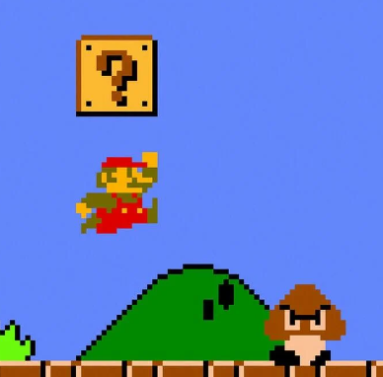
Operant Conditioning Example 3
Mario hits a question box and receives a power-up.
What behavior is being reinforced or punished?
Hitting the box
What is the consequence of the behavior?
Power-up
Is a stimulus being added (positive) or subtracted (negative)?
Added → positive
Does the outcome increase (reinforcement) or decrease (punishment) the likelihood of the behavior being repeated?
Increase → reinforcement
Positive reinforcement

Slide 38
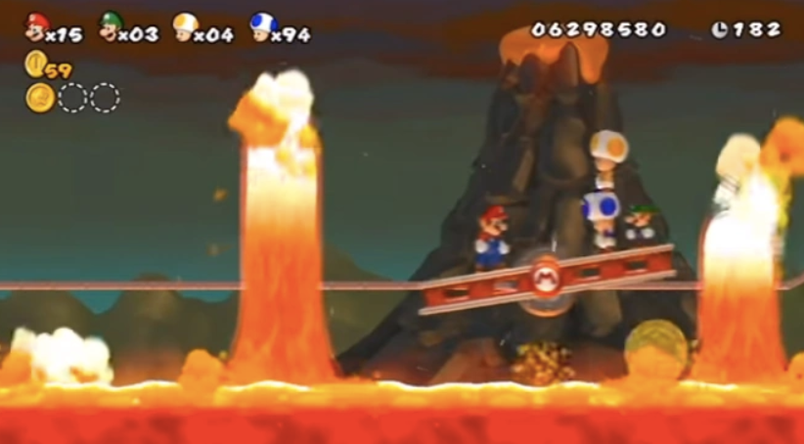
Operant Conditioning Example 4
Mario touches the lava and dies.
What behavior is being reinforced or punished?
Touching the lava
What is the consequence of the behavior?
Dying
Is a stimulus being added (positive) or subtracted (negative)?
Subtracted → negative
Does the outcome increase (reinforcement) or decrease (punishment) the likelihood of the behavior being repeated?
Decrease → punishment
Negative punishment

Slide 39
Operant Conditioning Activity
Positive Reinforcement - The Big Bang Theory – YouTube
Squirting with water/ mild electric shocks
Is a stimulus being added (positive) or subtracted (negative)?
Added → positive
Does the outcome increase (reinforcement) or decrease (punishment) the likelihood of the behavior being repeated?
Decrease → punishment
Positive punishment

Slide 40
Operant Conditioning Activity
Work alone or in groups.

Slide 41
Reinforcers in Video Games
Effective reinforcers depend on the player:
Clearing a level & advancing to next
Solving puzzles
Completing quests
Winning & losing
Power-ups
Acquisition of items
New skills, improved skills
Exploration/ new content/ storyline
Status, titles
Social reinforcers (friendships, group membership)

Slide 42
Problems with Punishment
Punishment tells what not to do but not what to do.
Punishment can create anxiety and fear, which interferes with future learning.
Punishment may lead to subversive behaviors (e.g. lying).
Punishment may model aggressive behaviors.
Instead:
Recommend a better behavior.
Punishment should occur immediately after the behavior.
Explain what behavior is being punished.
Be consistent.
Reinforce good behaviors instead of only punishing the bad.

Slide 43
Continuous vs. Partial Reinforcement
Continuous reinforcement: reinforcing the desired response every time it occurs.
Learning occurs rapidly.
Extinction is equally rapid.
Partial reinforcement: reinforcing a response only part of the time.
Learning occurs more slowly.
More resistant to extinction.
Higher rates of behavior.

Slide 44
Schedules of Reinforcement
 | Fixed | Variable
Ratio | Fixed ratio | Variable ratio
Interval | Fixed interval | Variable interval

Slide 45
Schedules of Reinforcement
Fixed: reinforced on a regular basis, predictable.
Variable: reinforced on an irregular basis, unpredictable.
Ratio schedule: based on number of responses.
Interval schedule: based on amount of time elapsed since last reinforcement.

Slide 46
Schedules of Reinforcement
Fixed ratio: provides reinforcement after a regular number of responses.
Variable ratio: provides reinforcement after an unpredictable number of responses.
Fixed interval: provides reinforcement after a fixed amount of time has elapsed.
Variable interval: provides reinforcement after an unpredictable amount of time.

Slide 47
Fixed Ratio Examples
Useful for helping a player learn new behaviors and mechanics of the game.
Rat hits the bar, gets a pellet of food every time.
Mario hits a question box, he gets a coin or power-up.
Kill creeps, get gold and experience.
Repetitive behaviors to complete quests.

Slide 48
Variable Ratio Examples
Usually results in the highest rate of behavior.
Helps maintain in-game behaviors and keeps players interested.
Drop rates
Encountering a Pokémon (rare, shiny, perfect stats)
Posting on social media
Claw machines
It's not you. Claw machines are rigged. - YouTube

Slide 49
Fixed Interval Examples
Fixed Interval
Daily quests or rewards
Weekly raids
Upgrading structures in Boom Beach
Fixed amount of time before ult can be used again

Slide 50
Variable Interval Examples
Variable Interval
Items re-spawning after a variable amount of time
Monsters that appear and re-spawn periodically
Characters resurrecting
Waiting for a text back
Checking if grades are posted

Slide 51
Schedules of Reinforcement Activity
Work alone or in groups.

Slide 52
Habituation & Sensitization
Habituation
Decreased strength of a response after repeated presentations of a stimulus.
Short-term
Long-term habituation
Sensitization
Repeated stimuli creates higher sensitivity.
Usually short-lived.

Slide 53
Observational Learning
Observational learning: learning by observing others.
Modeling: observing another’s behavior and then imitating that behavior.
Bandura’s Bobo Doll Experiment:
Three groups of children: one observed aggressive behavior, one observed gentle behavior, one observed no behavior.
Child first sees adult modeling the behavior.
Led to a room full of toys, then to a different room with less toys.

Slide 54
Observational Learning
Bandura's Bobo Doll Experiment - YouTube
Bandura’s theory challenged behaviorist view that rewards & punishments are essential for learning.
Supported theory that people could learn by observing others.
Experimental study: causality link can be drawn.
Generalizability? Bobo doll was a toy.
Duration of behavior change?
Much of the research between violent media and aggression is correlational.

Slide 55
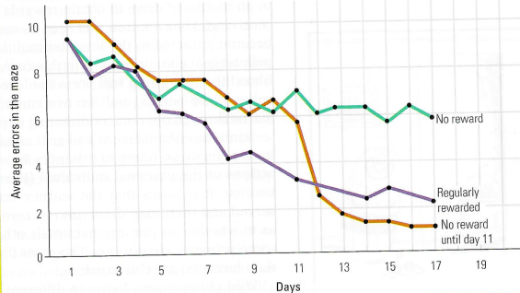
Latent Learning
Latent learning
Learning that occurs but is not apparent until there is an incentive to demonstrate it.
Can learn from experience, with or without reinforcement.
Experiment with rats who were always reinforced, never reinforced, and reinforced starting on Day 11.
Play & exploration as vehicle for learning.

